Slide 1
Christmas

Slide 2
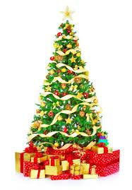
Christmas tree
Decorations:
Lights,
Tinsel,
Baubles,
Star,
Candles.

Slide 3
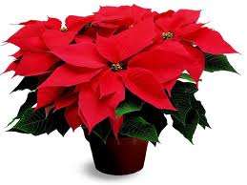
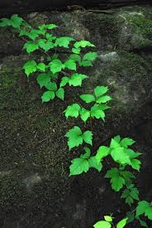
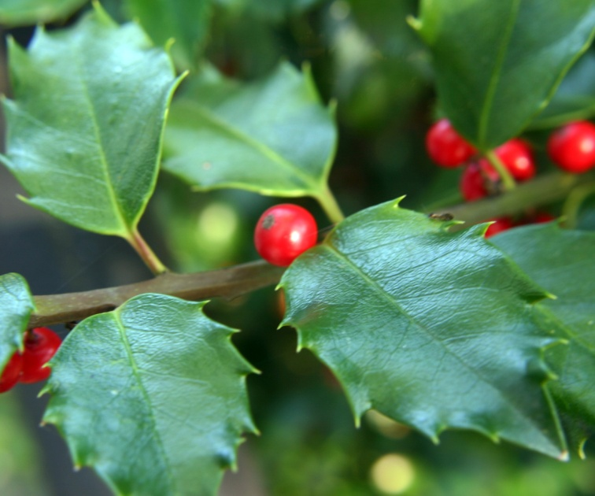
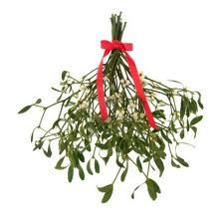
Flowers
Holly,
Ivy,
Poinsettia,
Mistletoe,
Wreath.

Slide 4
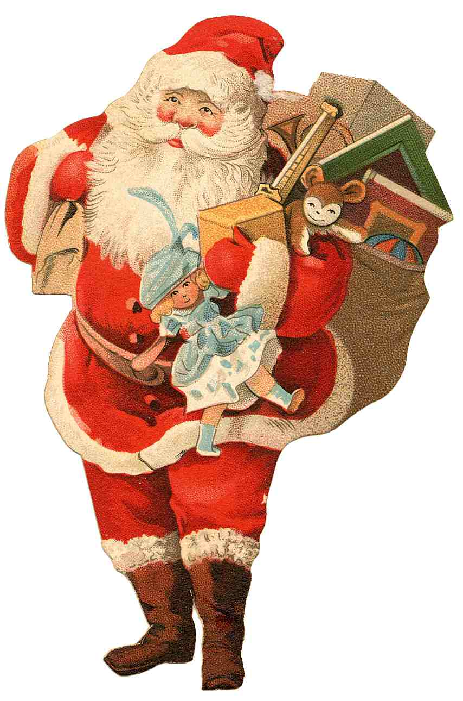
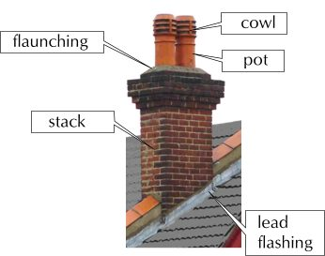
Presents
Stocking,
Cracker,
Santa Claus,
Reindeers,
Bells,
Sleigh,
Chimney.

Slide 5
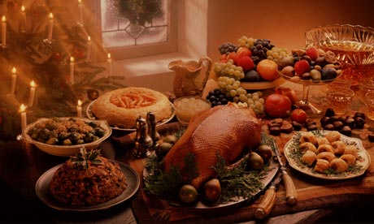
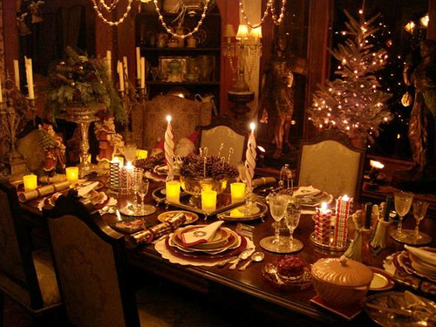
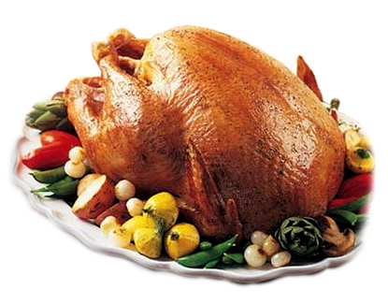
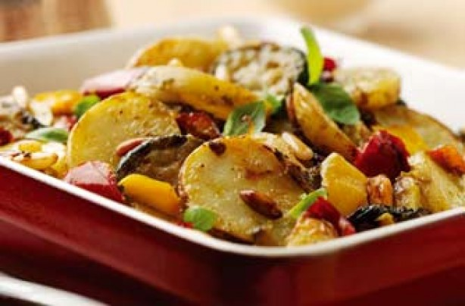
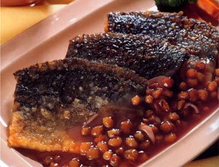
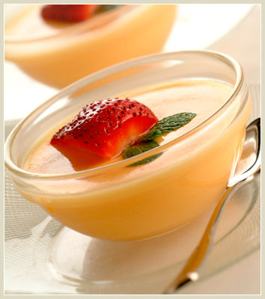
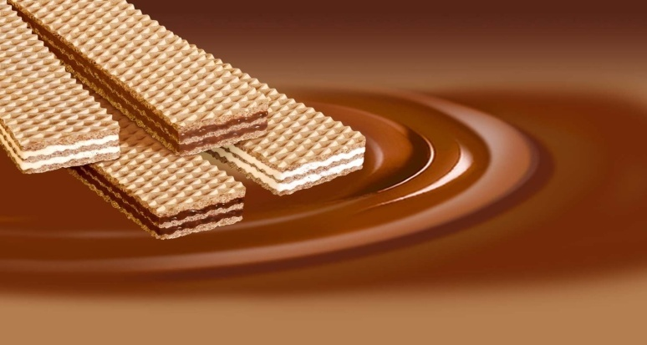
Food
Christmas Eve Dinner:
Carp,
Twelve dishes ,
Wafer,
Christmas Dinner:
Roast Turkey,
Christmas Pudding,
Potatoes and vegetables.

Slide 6
Christmas carols
„White Christmas”
I'm dreaming of a White Christmas Just like the ones I used to know Where the treetops glisten And children listen To hear sleigh bells in the snow I'm dreaming of a White Christmas With every Christmas card I write "May your days be merry and bright And may all your Christmases be white" (I'm dreaming of a White Christmas Just like the ones I used to know Where the treetops glisten And children listen To hear sleigh bells in the snow) (I'm dreaming of a White Christmas With every Christmas card I write "May your days be merry and bright") "And may all your Christmases be white"

Slide 7
Christmas cards
Wishes,
Greetings.

Slide 8
Merry Christmas everyone!

